Slide 1

Elastos(和欣)操作系统介绍

Slide 2

提纲
Elastos操作系统概述
应用开发
操作系统裁剪
操作系统体系架构
驱动与板卡支持
应用程序开发XML-Glue
Q & A

Slide 3

提纲
Elastos操作系统概述
  历史定位
  什么是elastos

Slide 4
第一代操作系统
DOS计算模型：
计算机应用软件控制操作系统；
操作系统控制终端用户
应用程序
操作系统
文件
lib
图形
lib
网络lib

Slide 5
第二代操作系统
Windows计算模型：
应用软件首先控制本地操作系统进行初始化，
然后放弃控制权给本地操作系统，
本地操作系统通过消息机制控制应用软件运行；
用户对应用软件，在给定范围内，具有“有限选择”
应用程序
操作系统
文件
lib
图形
lib
网络lib

Slide 6
未来的软件模型是WEB服务(SOA)
第三代操作系统——WEB服务计算模型：
网络操作系统根据不同安全、运营、用户需求，动态控制应用软件，WEB服务可以在因特网上任何地方运行；
随着不同WEB服务加载，用户对应用软件，具有“无限选择”
软件服务
排版
服务
MP3
服务
其他
服务
操作系统

Slide 7
什么是elastos?
微内核
  零活内核结构
最好构件运行平台
  嵌入式连网设备
与硬件无关
  只少量BSP代码汇编写成
多种CPU支持
  ARM, MIPS, x86 虚拟机

Slide 8
提纲
Elastos操作系统概述
应用开发支持
操作系统设计
体系架构
驱动与板卡支持
应用程序开发XML-Glue
Q & A

Slide 9
开发工具支持
Native Application Model
Managed Application Model
Platform
Builder
eMbedded
Visual C++
Visual Studio .NET
2003
C or C++
C or C++
C# or VB .NET
Win32
Applications
Win32
Applications
.NET Compact
Framework
Compiled
Runtime
Windows CE Operating System
Notes:
Speaker Notes:
Currently (SEP 2004) there are three separate tools for building applications. Platform Builder and eVC for native code and VS2003 for managed .NET Compact Framework code. The future will change that a bit (seen in next slide). At this point it’s important to point out the multiple tools, detailed a bit later on in this presentation, and to distinguish between “Managed” code and “native code”. A later slide will compare native and managed code so the discussion should be a framing one to provide context to everything else in the presentation.

Slide 10
Elastos的API
基于接口的API
  Windows CE subset familiar to Win32 programmers
  Some APIs specific to Windows CE: Database and Thread handling
CRT
  CE Databases, Object Store, D3D Mobile, AYGSHELL, etc…
系统资源
  Redundant WIN32 API functions are removed
  If the function is part of an API that is not supported by Windows CE, you will have to find another solution
  When developing a program for Windows CE, you must select the appropriate SDK and processor for the device on which your program is going to run

Slide 11
CAR构件技术

Slide 12
跨操作系统的构件平台
应用程序
统一的接口
和欣构件运行平台
和欣构件运行平台
和欣灵活内核
Windows
  提供与JAVA、.NET思想一脉相承的系统软件解决方案
    在WinXP上运行“和欣虚拟机”
    在WinCE上运行“和欣虚拟机”
    在Linux上运行“和欣虚拟机”
    在嵌入式设备上直接运行“和欣”操作系统

Slide 13
通常应用开发顺序:
Get an SDK for specified Windows CE platform.
Writing Code and debug under Windows CE Emulator.
Make release build and run it on real target device, if necessary debug the app on device using ActiveSync.

Slide 14
提纲
Elastos操作系统概述
应用开发
操作系统裁剪
体系架构
驱动与板卡支持
应用程序开发XML-Glue
Q & A
Notes:
一个嵌入式的系统软件开发，往往是从操作系统的裁减规划开始的
在IT术语中，内核既是操作系统的心脏，也是它的大脑，因为内核控制着基本的硬件。内核是操作系统的核心，具有很多最基本功能，如虚拟内存、多任务、共享库、需求加载、共享的写时拷贝（copy-on-write）可执行程序和TCP/IP网络功能。

Slide 15
完整的OS编译过程
Catalog Items
SYSGEN
  Filters modules and components based on OS Design settings
Build
  Uses DIRS, SOURCES and OS Design Workspace to build Source Code for the BSP and applications
BUILDREL
  Copies files into the Flat Release Directory
Make Image
  Generates the OS Run-Time Image from the files in the Flat Release Directory
1
1
2
Sysgen
OS Design
BSP
/
project
Filter
Source Code
Build
2
3
BUILDREL
3
%
_
FLATRELEASEDIR
%
4
4
Run
-
Time
Image

Slide 16
提纲
Elastos操作系统概述
应用开发
操作系统裁剪
操作系统体系架构
驱动与板卡支持
应用程序开发XML-Glue
Q & A

Slide 17
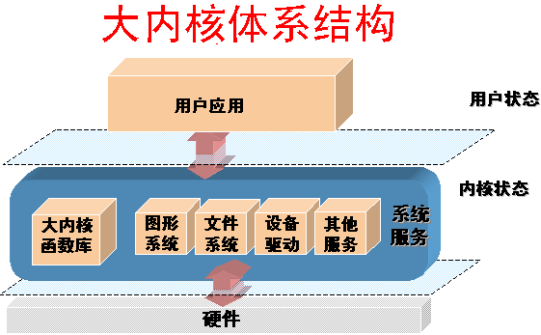
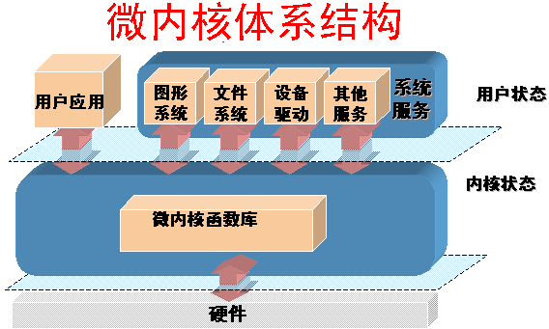
传统操作系统体系结构
优：减少进程间通信和状态 切换，效率高
劣：内核庞大，占有资源多， 剪裁不易，稳定性、 安全性不好
优：内核精练，便于剪裁、移植， 稳定性好
劣：用户态与内核态切换频繁， 系统效率降低

Slide 18

灵活内核体系结构
速度可选、灵活性可选、安全性可选、可网络运行
用户应用
其他服务
系统服务
图形
系统
文件
系统
设备
驱动
用户状态
内核状态
内核进程
图形
系统
文件
系统
设备
驱动
其他服务
硬件

Slide 19
创新的OS体系结构--灵活内核
Elastos技术解决了安全性和速度要求的矛盾
  用户根据需求灵活决定系统服务构件运行空间
操作系统设计的最高境界：无为
  用户根据需求量身订制系统服务
和欣
系统安全、稳定性考虑
应用构件
用户状态
设备驱动、
核心构件
内核状态
灵活内核
系统速度、效率考虑
硬件

Slide 20
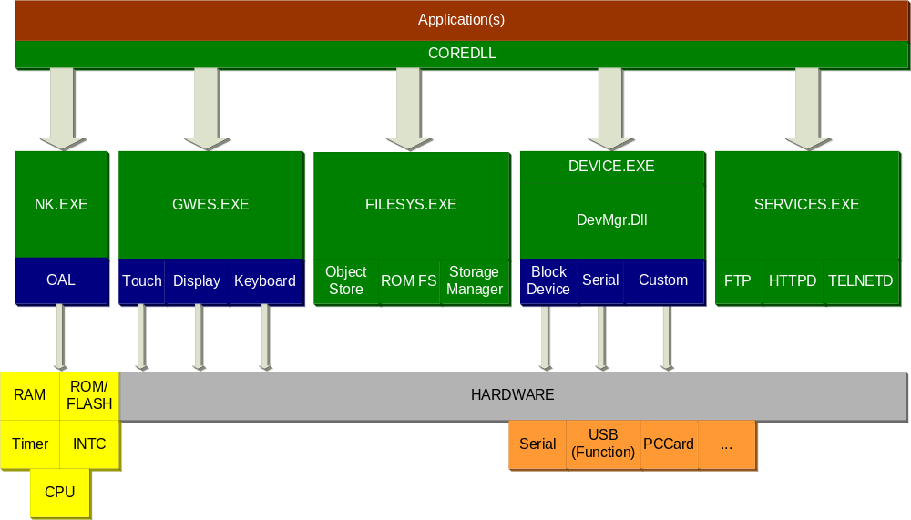
体系结构图

Slide 21
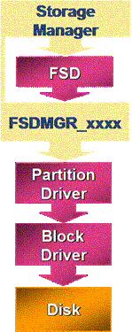
存储设备管理
Responsible for:
  Storage device driver
  Partition device driver
  File System device driver
  File System filter

Slide 22
系统引用代码路径
CreateFile(…)

Slide 23
进程（3.pdf）
Static context within which one or more threads run
  Processes aren’t scheduled to run – threads are.
The maximum number of simultaneous processes is limited 32 processes because:
  It is a reasonable limit for most embedded devices, as using multi-thread is recommended over multi-processes
  Architecture of some supported CPUs have fixed MMU mappings.
Windows CE uses the same loading and unloading mechanism as Windows XP
  (and other desktop Win32 versions of Windows)
Support for console applications
  But not the same API as desktop Win32
Call CreateProcess() to start a process

Slide 24
线程
Unit of execution in Win32
Scheduled by the OS based on Priority
Higher priority threads pre-empt lower priority threads when ready to run
Threads at the same priority are scheduled in a Round-Robin fashion.
Default Quantum is 100ms configurable by OEM in OAL
  Can also be programmed per thread at run time.

Slide 25
处理器调度

Slide 26
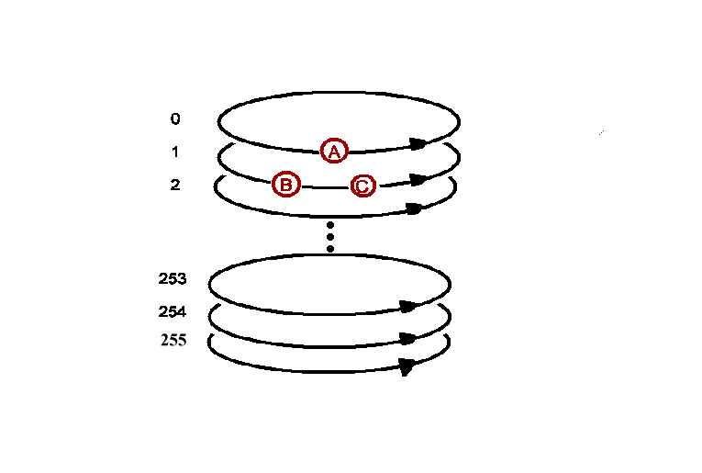
线程优先级
Thread A is in the highest priority and runs until blocked or completion
Thread B and C run in “round-robin” as long as thread A is blocked
In round-robin each thread runs for a specific amount of time – called a quantum
The lower the priority number the higher the priority

Slide 27
同步对象
Thread
  Requests a synchronization object and blocks while object is not in “Signaled” state
  Resumes when the object it is in “Signaled” state
Synchronization Object Types
  Critical Section
  Mutex
  Semaphore
  Event
Also can use Interlocked functions & point-to-point message queue
Notes:
NOTE: The signaled and non signaled states are a concept that also applies to Thread handles returned from CreateThread() and process handles returned from CreateProcess(). The handles are signaled while the thread or process is still active. Both handles are still valid after the thread or process exits and will be in the signaled state at that point.

Slide 28
内存管理
Application
C Runtime (mallc, new…)
Logical Memory (Heap, stack)
Virtual Memory
Physical Memory
* Storage Device
* Exist only in desktop windows

Slide 29
虚拟内存
Virtual memory management
  Windows CE provides only one virtual address space of 4 GB for all the applications to use
  System still maintains protection between processes
  Allows faster inter-process thread migration.
Using virtual memory
  Allocate large blocks of memory
  Windows CE manages virtual memory in 64 KB blocks
Using the local heap
  region of reserved virtual memory space that Kernel manages for your application
Using the stack
  Is the storage area for variables that are referenced in a function
Reserved
2GB
Memory Mapping
(Shared)
Slot 32:Process32
2GB
.
.
.
Slot 1:XIP DLL Code
32MB
Slot 0:Active Process

Slide 30
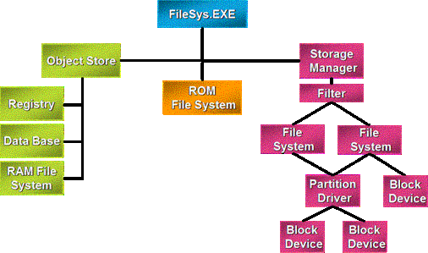
文件系统概览

Slide 31
网络系统概览

Slide 32
提纲
Elastos操作系统概述
应用开发
操作系统设计
体系架构
驱动与板卡支持
应用程序开发XML-Glue
Q & A

Slide 33
设备驱动
User Mode DLL
Expose predefined interfaces
Loaded by Device.exe at boot time or via API

Slide 34
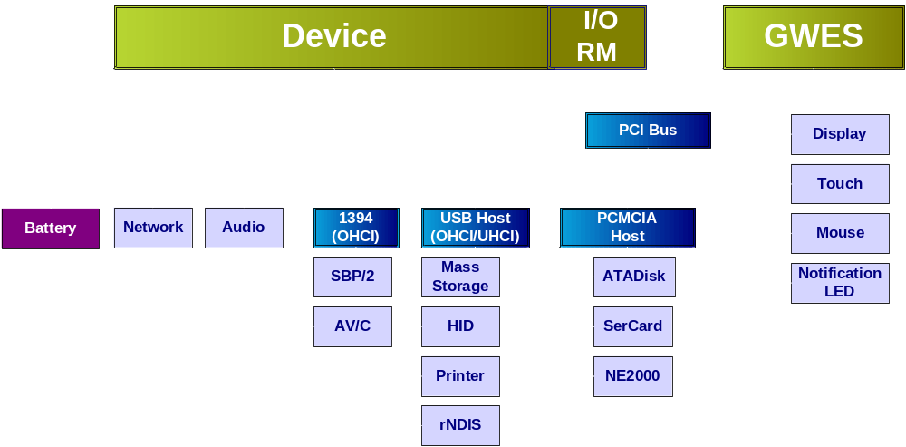
驱动体系架构

Slide 35

中断编程
Driver
IST
SYSINTR_CHAIN
IISR
IISR₁
IISR₂
IISR_{n}
Kernel
Except.
Handler
SYSINTR_xx
SYSINTR_NOP
Set
Event
PSR
SYSINTR_ID
OAL
NKCallIntChain(IRQ)
ISR
HW
None
Higher Priority IRQs Enabled
IRQ Masked

Slide 36
IST（中断服务线程 Interrupt Service Thread）
Is user-mode thread of device drivers for
built-in devices
Does the actual processing of the interrupt
Creates an event object associated with the logical interrupt by calling CreateEvent function
IST remains idle most of the time, awakened when the kernel signals the event object
IST usually runs at above-normal priority, boost priority with CeSetThreadPriority function

Slide 37
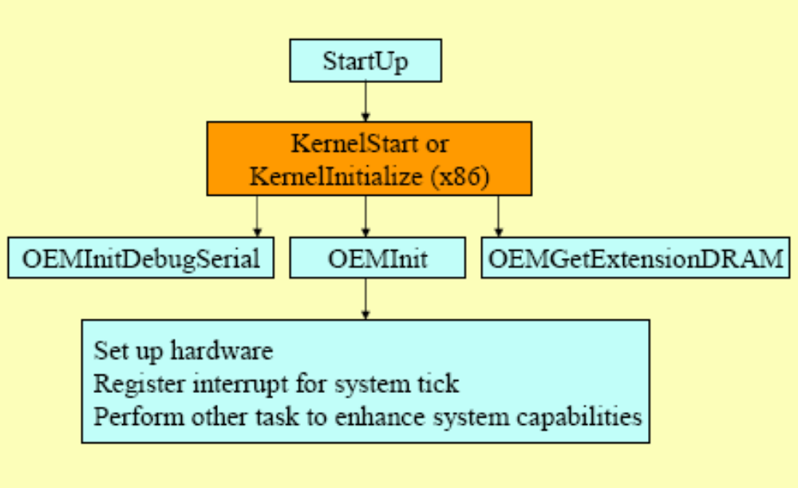
内核工作时的样子

Slide 38
操作系统启动

Slide 39
提纲
Elastos操作系统概述
应用开发
操作系统设计
体系架构
驱动与板卡支持
应用程序开发XML-Glue
Q & A

Slide 40
Elastos技术体系
和欣技术体系中，包括了以下部分：
CAR（Carefree Application Run-Time）构件技术：面向构件的编程模型及编程规范；
和欣构件运行平台：CAR构件的运行环境，支持应用软件跨平台；
和欣操作系统：基于构件技术，支持构件化应用的嵌入式操作系统；
和欣灵活内核：构件化操作系统中"灵活"的内核体系结构；
和欣SDK：面向构件化编程的应用软件集成开发环境。

Slide 41
Thanks!
Question?

